Slide 1


CROWD DISASTER MANAGEMENT
Introducing “ResqueNet”:
Your Disaster Relief Coordination

Slide 2


CONTENT
01
02
03
04
Problem Statement
DataFlow Diagram
Who are the users?
Solution
05
06
07
Development Plan
Marketing Analysis
Development gen and marketing strategy

Slide 3



RESQUENET
PROBLEM WE ARE SOLVING
Current disaster relief efforts face challenges in efficiently matching aid supplies with immediate needs due to a lack of coordination and real-time data.
ResqueNet addresses this by:
01
Streamlining the process of request handling and delivery
02
Ensuring that aid matches actual needs based on real-time data.
03
Prioritizing urgent needs and reducing delays in response
Hackfest 24

Slide 4

RESQUENET
Affected Individuals
Who are the Stakeholders?
NGOs and Organizations
Delivery Teams
Hackfest 24

Slide 5
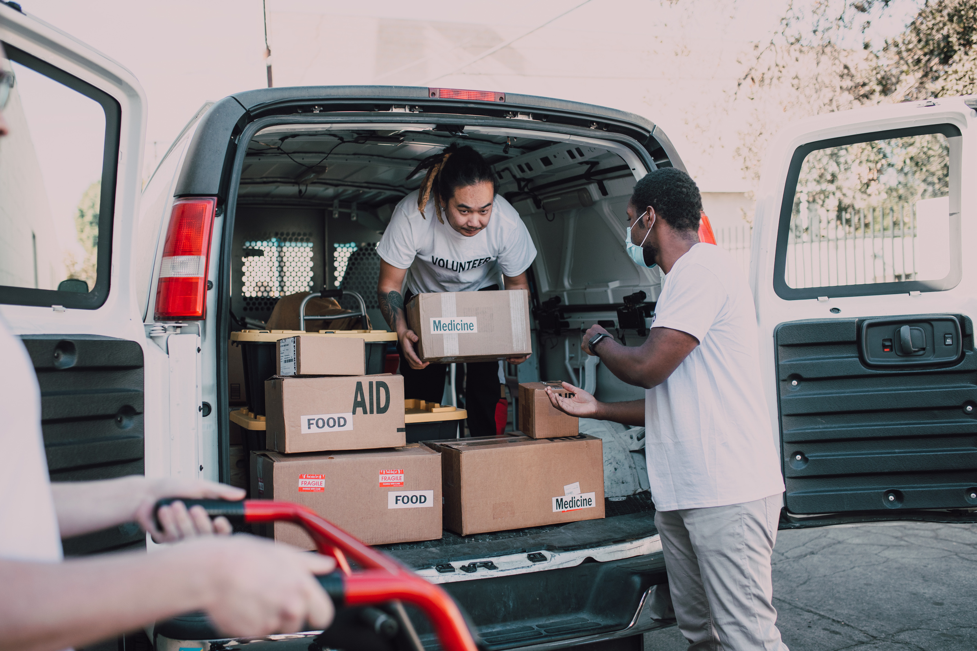
SOLUTION
A real-time map with markers indicating locations needing specific resources like food, medicine, or shelter.
Clustering nearby markers with similar needs into one larger marker for better visualization and reduced clutter.
A single marker shows multiple needs in the same area.
NGOs can filter displayed needs based on what type of aid they provide
Establishing a system for verified individuals and NGOs to register and submit data.
Algorithms are used to match needs with resources, prioritize deliveries based on urgency, and consider factors like severity of need, number of people affected, and distance to resources.

Slide 6





DataFlow Diagram
User Request
NGO
passes data
to
through
to
Server
handles
logistics

Slide 7

RESQUENET
DEVELOPMENT PLAN
01:
SHORT-TERM GOALS
02:
MEDIUM- term goals
03:
LONG-TERM GOALS
Establish a fixed 3-digit number and test the initial functionalities with a select group of users for feedback.
Implement real-time tracking and updates for users and NGOs
Begin pilot testing in a limited flood-prone region.
Integrate with SOS services for emergency alerts and requirements.
Expand to additional disaster scenarios beyond floods.
Scale the platform for use in other regions and countries.
Hackfest 24

Slide 8





RESQUENET
MARKET ANALYSIS
Targeted User Base: Focus on flood-prone regions in India, a country with a high internet penetration rate. This ensures a large pool of potential users: victims, NGOs, and donors.
Partnership Potential: Collaborating with local flood management authorities and NGOs. This strengthens user trust, boosts adoption, and enhances data accuracy.
Gather Feedback and Iterate: Collecting feedback from users to identify areas for improvement and iterate on our design.
Hackfest 24

Slide 9

RESQUENET
REVENUE GENERATION and marketing STRATEGY
Government grants: Seek grants and funding from government bodies, international aid organizations, and disaster relief funds.
Building trust and Credibility - Success stories, endorsements from a highly reputed org.
Content marketing, Social media presence
Local and institution partnership.
Hackfest 24

